Slide 1
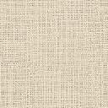
Lab Program 7
Write a Program to read a digital image. Split and display image into 4 quadrants, up, down, right and left.

Slide 2
7. Write a Program to read a digital image. Split and display image into 4 quadrants, up, down, right and left.
import cv2
import numpy as np
# Read the image
img = cv2.imread(image_pat)
# Get the height and width of the image
height, width = img.shape[:2]
# Split the image into four quadrants
quad1 = img[:height//2, :width//2]
quad2 = img[:height//2, width//2:]
quad3 = img[height//2:, :width//2]
quad4 = img[height//2:, width//2:]

Slide 3
7. Write a Program to read a digital image. Split and display image into 4 quadrants, up, down, right and left.
plt.figure(figsize=(10, 5))
plt.subplot(1, 2, 1)
plt.imshow(quad1)
plt.title("1")
plt.axis("off")
plt.subplot(1, 2, 2)
plt.imshow(quad2)
plt.title("2")
plt.axis("off")

Slide 4
7. Write a Program to read a digital image. Split and display image into 4 quadrants, up, down, right and left.
plt.figure(figsize=(10, 5))
plt.subplot(1, 2, 1)
plt.imshow(quad3)
plt.title("3")
plt.axis("off")
plt.subplot(1, 2, 2)
plt.imshow(quad4)
plt.title("4")
plt.axis("off")
plt.show()

Slide 5
OUTPUT:

Slide 6
Lab Program 8
Write a program to show rotation, scaling, and translation on an image.

Slide 7
8. Write a program to show rotation, scaling, and translation on an image.
#Rotation and scaling of image
import cv2
def translate_image(image, dx, dy):
rows, cols = image.shape[:2]
translation_matrix = np.float32([[1, 0, dx], [0, 1, dy]])
translated_image = cv2.warpAffine(image, translation_matrix, (cols, rows))
return translated_image
# Read the image
image = cv2.imread('/content/sample_data/3.png')
# Get image dimensions
height, width = image.shape[:2]

Slide 8
8. Write a program to show rotation, scaling, and translation on an image.
# Calculate the center coordinates of the image
center = (width // 2, height // 2)
rotation_value = int(input("Enter the degree of Rotation:"))
scaling_value = int(input("Enter the zooming factor:"))

Slide 9
8. Write a program to show rotation, scaling, and translation on an image.
# Create the 2D rotation matrix
rotated = cv2.getRotationMatrix2D(center=center, angle=rotation_value, scale=1)
rotated_image = cv2.warpAffine(src=image, M=rotated, dsize=(width, height))
scaled = cv2.getRotationMatrix2D(center=center, angle=0, scale=scaling_value)
scaled_image = cv2.warpAffine(src=rotated_image, M=scaled, dsize=(width, height))
h = int(input("How many pixels you want the image to be translated horizontally? "))
v = int(input("How many pixels you want the image to be translated vertically? "))
translated_image = translate_image(scaled_image, dx=h, dy=v)
cv2.imwrite('Final_image.png', translated_image)

Slide 10
OUTPUT:

Slide 11
Lab Program 9
Read an image and extract and display low-level features such as edges, textures using filtering techniques.

Slide 12
9. Read an image and extract and display low-level features such as edges, textures using filtering techniques.
import cv2
import numpy as np
# Load the image
image_path = "image/atc.jpg" # Replace with the path to your image
img = cv2.imread(image_path)
# Convert the image to grayscale
gray = cv2.cvtColor(img, cv2.COLOR_BGR2GRAY)
# Edge detection
edges = cv2.Canny(gray, 100, 200) # Use Canny edge detector

Slide 13
9. Read an image and extract and display low-level features such as edges, textures using filtering techniques.
# Texture extraction
kernel = np.ones((5, 5), np.float32) / 25 # Define a 5x5 averaging kernel
texture = cv2.filter2D(gray, -1, kernel) # Apply the averaging filter for texture extraction
# Display the original image, edges, and texture
cv2.imshow("Original Image", img)
cv2.imshow("Edges", edges)
cv2.imshow("Texture", texture)
# Wait for a key press and then close all windows
cv2.waitKey(0)
cv2.destroyAllWindows()

Slide 14
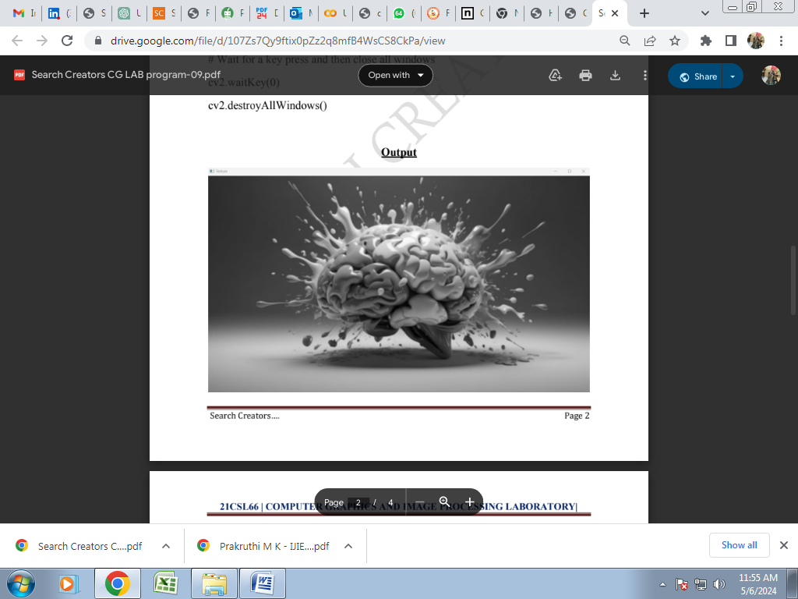
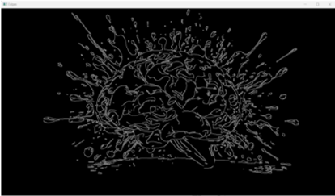
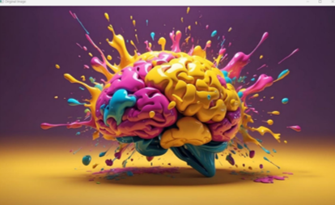
OUTPUT:

Slide 15
Lab Program 10
Write a program to blur and smoothing an image.

Slide 16
10. Write a program to blur and smoothing an image.
img = cv2.imread("/content/sample_data/smaple.jpg",cv2.IMREAD_GRAYSCALE)
image_array = np.array(img)
print(image_array)
def sharpen():
return np.array([[1,1,1],[1,1,1],[1,1,1]])
def filtering(image, kernel):
m, n = kernel.shape
if (m == n):
y, x = image.shape
y = y - m + 1 # shape of image - shape of kernel + 1
x = x - m + 1

Slide 17
10. Write a program to blur and smoothing an image.
new_image = np.zeros((y,x))
for i in range(y):
for j in range(x):
new_image[i][j] = np.sum(image[i:i+m, j:j+m]*kernel)
return new_image
# Display the original and sharpened images
plt.figure(figsize=(10, 5))
plt.subplot(1, 2, 1)
plt.imshow(image_array,cmap='gray')
plt.title("Original Grayscale Image")
plt.axis("off")

Slide 18
10. Write a program to blur and smoothing an image.
plt.subplot(1, 2, 2)
plt.imshow(filtering(image_array, sharpen()),cmap='gray')
plt.title("Blurred Image")
plt.axis("off")
plt.show()

Slide 19
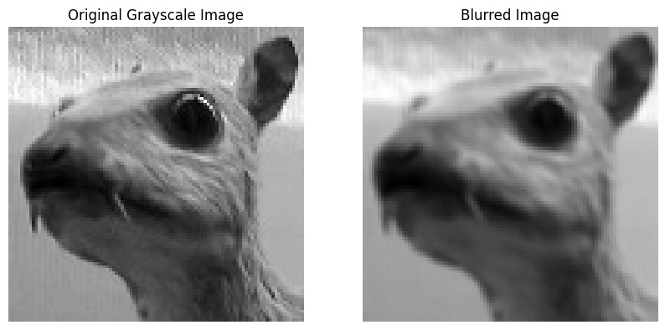
OUTPUT:

Slide 20
Lab Program 11
Write a program to contour an image.

Slide 21
11. Write a program to contour an image.
import cv2
import numpy as np
image_path = '1.png'
image = cv2.imread(image_path)
# Convert the image to grayscale (contours work best on binary images)
gray = cv2.cvtColor(image, cv2.COLOR_BGR2GRAY)
# Apply thresholding (you can use other techniques like Sobel edges)
_, binary_image = cv2.threshold(gray, 127, 255, cv2.THRESH_BINARY)
# Find contours
contours, _ = cv2.findContours(binary_image, cv2.RETR_EXTERNAL, cv2.CHAIN_APPROX_SIMPLE)

Slide 22
11. Write a program to contour an image.
# Draw all contours on the original image
cv2.drawContours(image, contours, -1, (0, 255, 0), 3)
# Display the result
cv2.imshow('Contours', image)
cv2.waitKey(0)
cv2.destroyAllWindows()

Slide 23
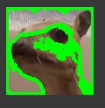
OUTPUT:

Slide 24
Lab Program 12
Write a program to detect a face/s in an image.

Slide 25
12. Write a program to detect a face/s in an image.
import cv2
# Load the pre-trained Haar Cascade classifier for face detection
face_cascade = cv2.CascadeClassifier(cv2.data.haarcascades + 'haarcascade_frontalface_default.xml')
eye_cascade = cv2.CascadeClassifier(cv2.data.haarcascades + 'haarcascade_eye.xml')
# Read the input image (replace 'your_image.jpg' with the actual image path)
image_path = 'face.jpeg'
image = cv2.imread(image_path)
# Convert the image to grayscale
gray = cv2.cvtColor(image, cv2.COLOR_BGR2GRAY)

Slide 26
12. Write a program to detect a face/s in an image.
# Detect faces in the image
faces = face_cascade.detectMultiScale(gray, scaleFactor=1.3, minNeighbors=5)
# Draw rectangles around detected faces
for (x, y, w, h) in faces:
cv2.rectangle(image, (x, y), (x + w, y + h), (255, 0, 0), 2)
# Save or display the result
cv2.imwrite('detected_faces.jpg', image) # Save the result
cv2.imshow('Detected Faces', image) # Display the result
cv2.waitKey(0)
cv2.destroyAllWindows()

Slide 27
OUTPUT:

